Slide 1
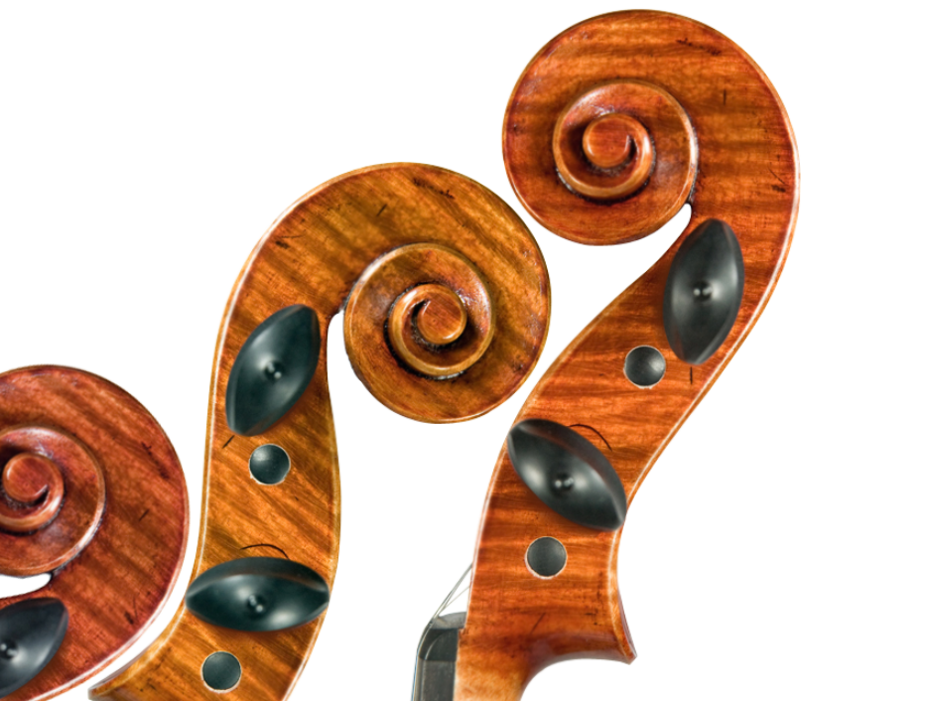
THE COMPOSER
COMPOSERS
IN THE CURRICULUM

Slide 2
Background
THE COMPOSER
MMus thesis: ‘A Change of Score’; Insights into the experiences of female identifying composers in Ireland
Leaving certificate syllabus portrays a history of music lacking in female identifying composers
New Junior cycle curriculum- ‘place to recommend’ female composers

Slide 3
Issues
THE COMPOSER
Lack of resources
Lack of time
Difficulty in finding easily accessible repertoire that fits into the learning objectives of the course

Slide 4
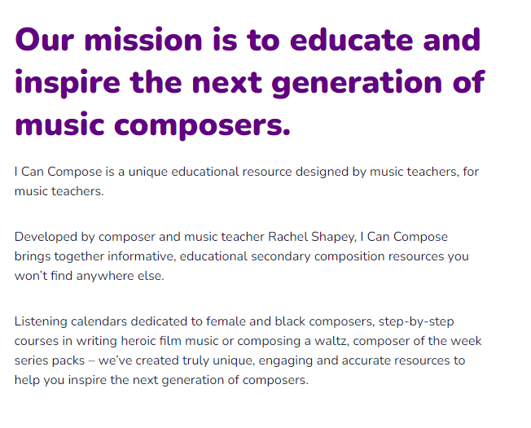
Idea Model
THE COMPOSER
Present a mock website to share teaching resources on female identifying composers for the Junior Cycle programme
Today's talk: Jane 0’Leary and Eimear Noone.
‘I Can Compose’
English website
Contains teaching materials on female identifying composers for the secondary classroom.

Slide 5
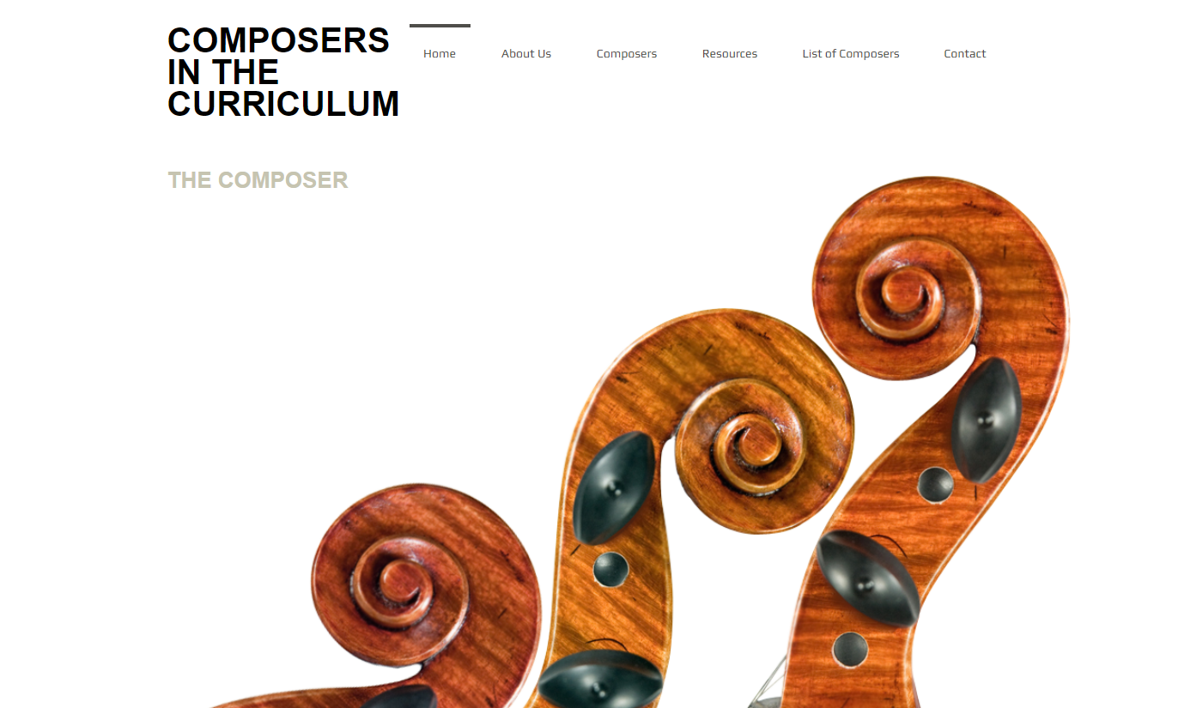
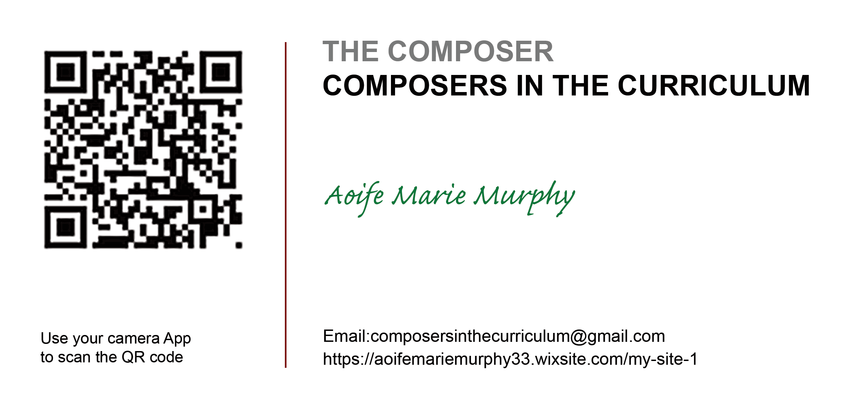
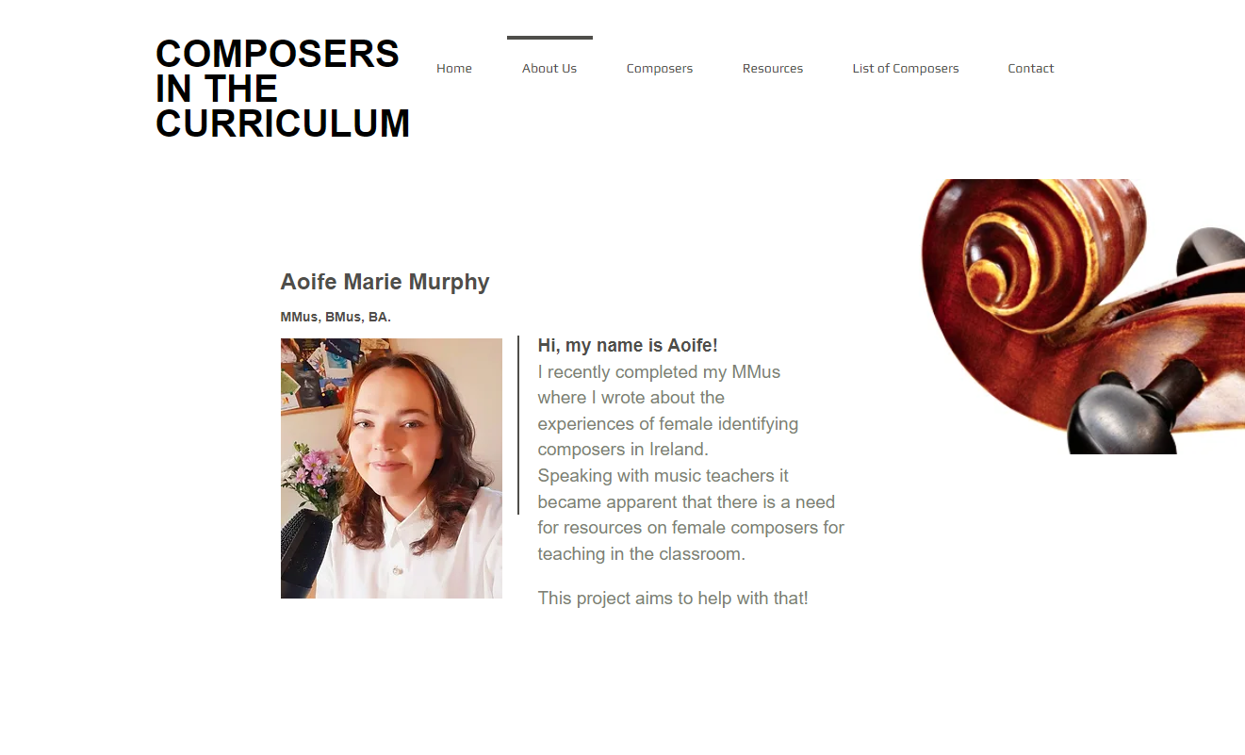
The Website
THE COMPOSER
Pages from the website

Slide 6
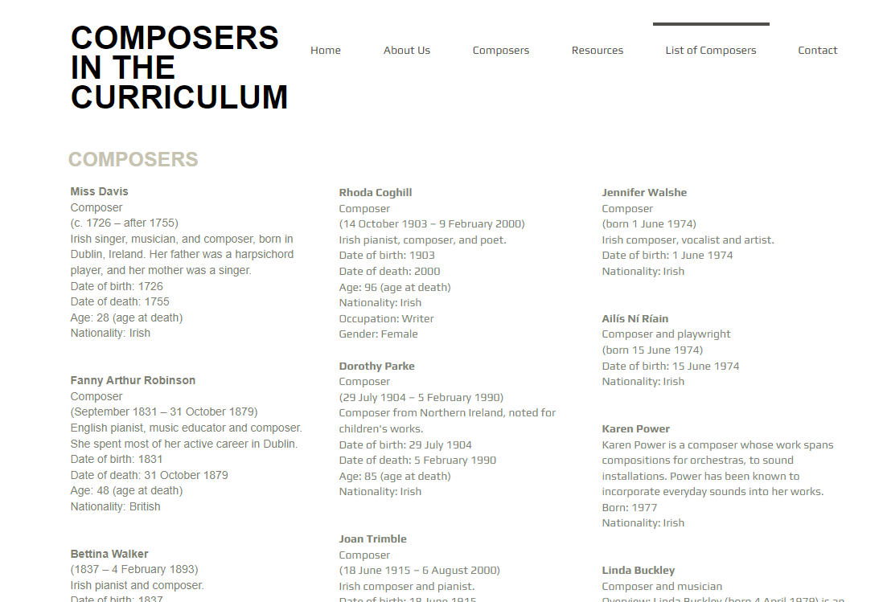
THE COMPOSER
The List
Non-exhaustive
Still growing

Slide 7
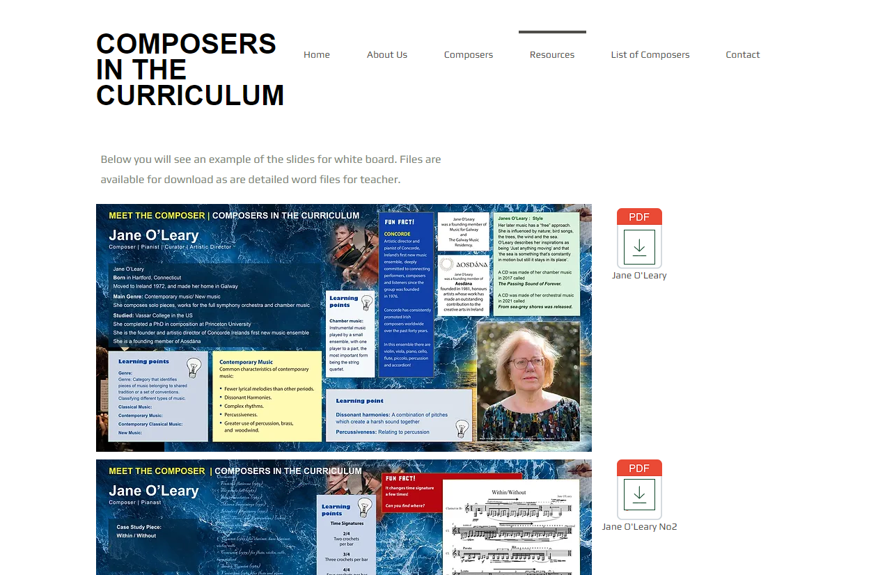
The Resources
THE COMPOSER
White Board Posters
Word docs

Slide 8
THE COMPOSER

Slide 9
THE COMPOSER

Slide 10
THE COMPOSER

Slide 11
THE COMPOSER

Slide 12
Feedback
THE COMPOSER

Slide 13
Thank you!
THE COMPOSER

